Slide 1
Money
and Financial
Mathematics

Slide 2
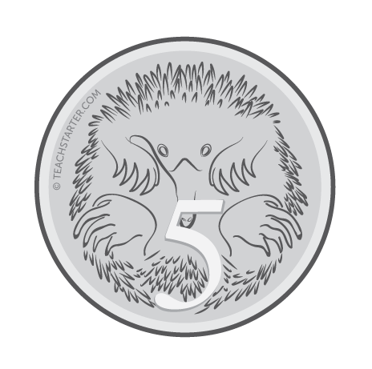
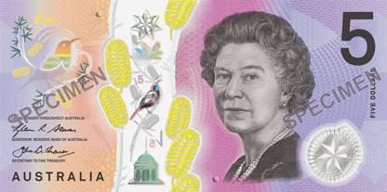
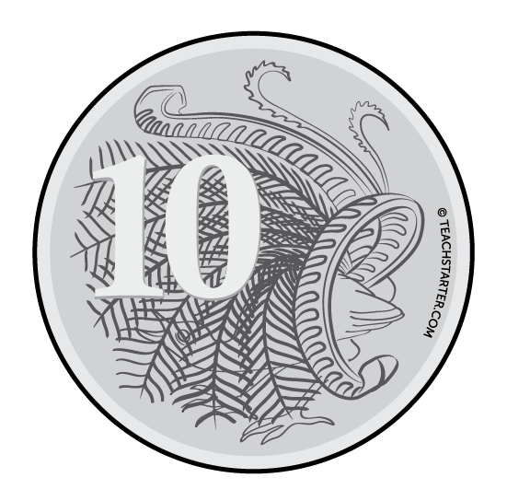
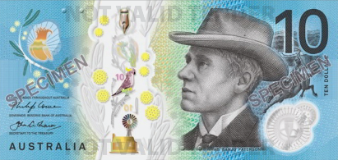
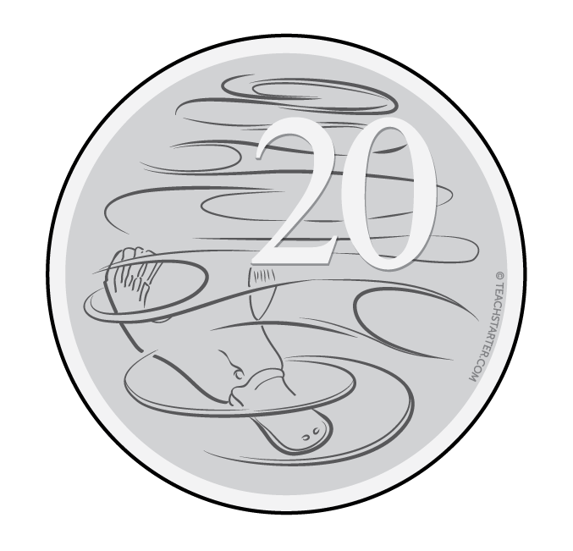
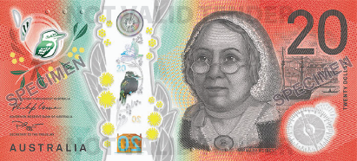
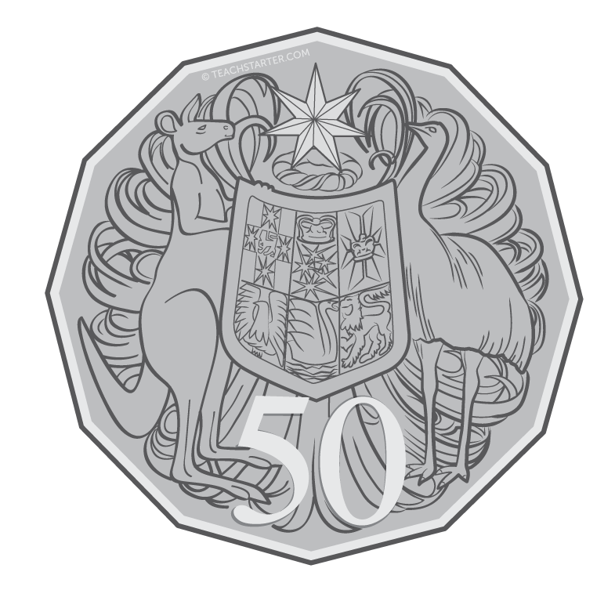
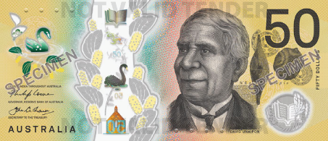
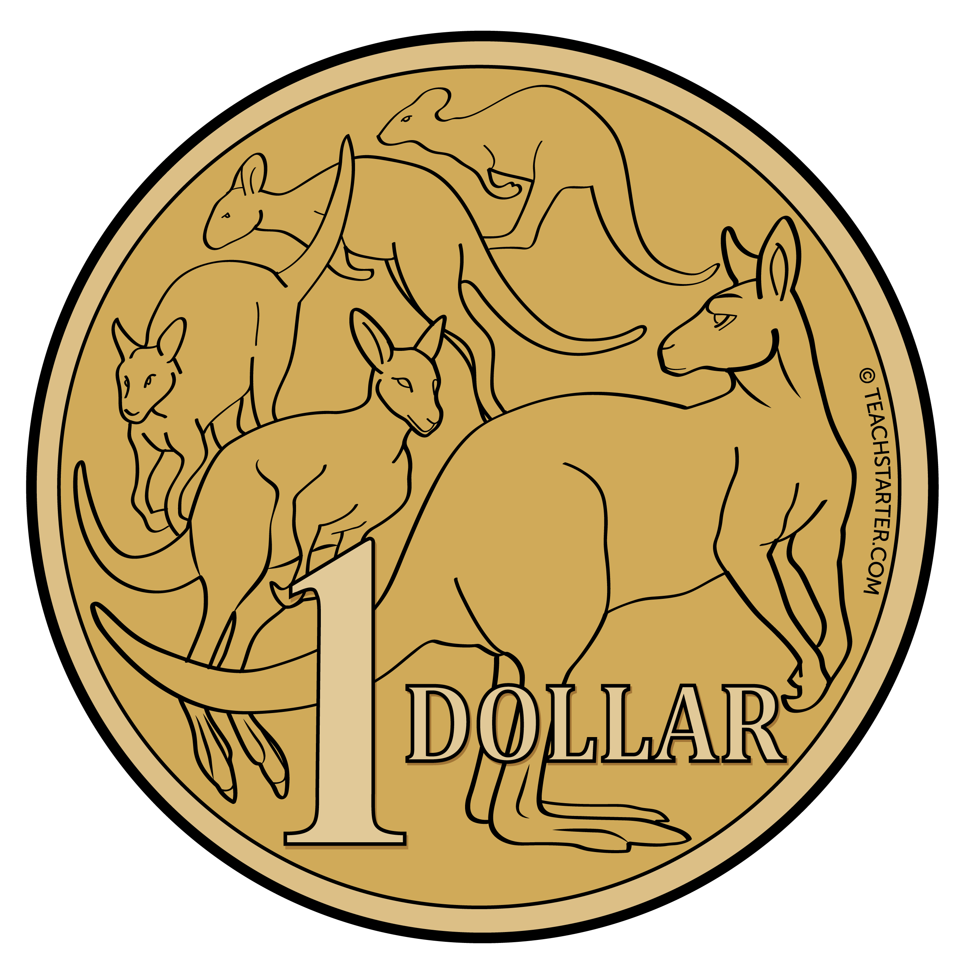
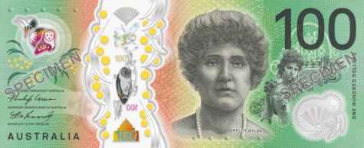
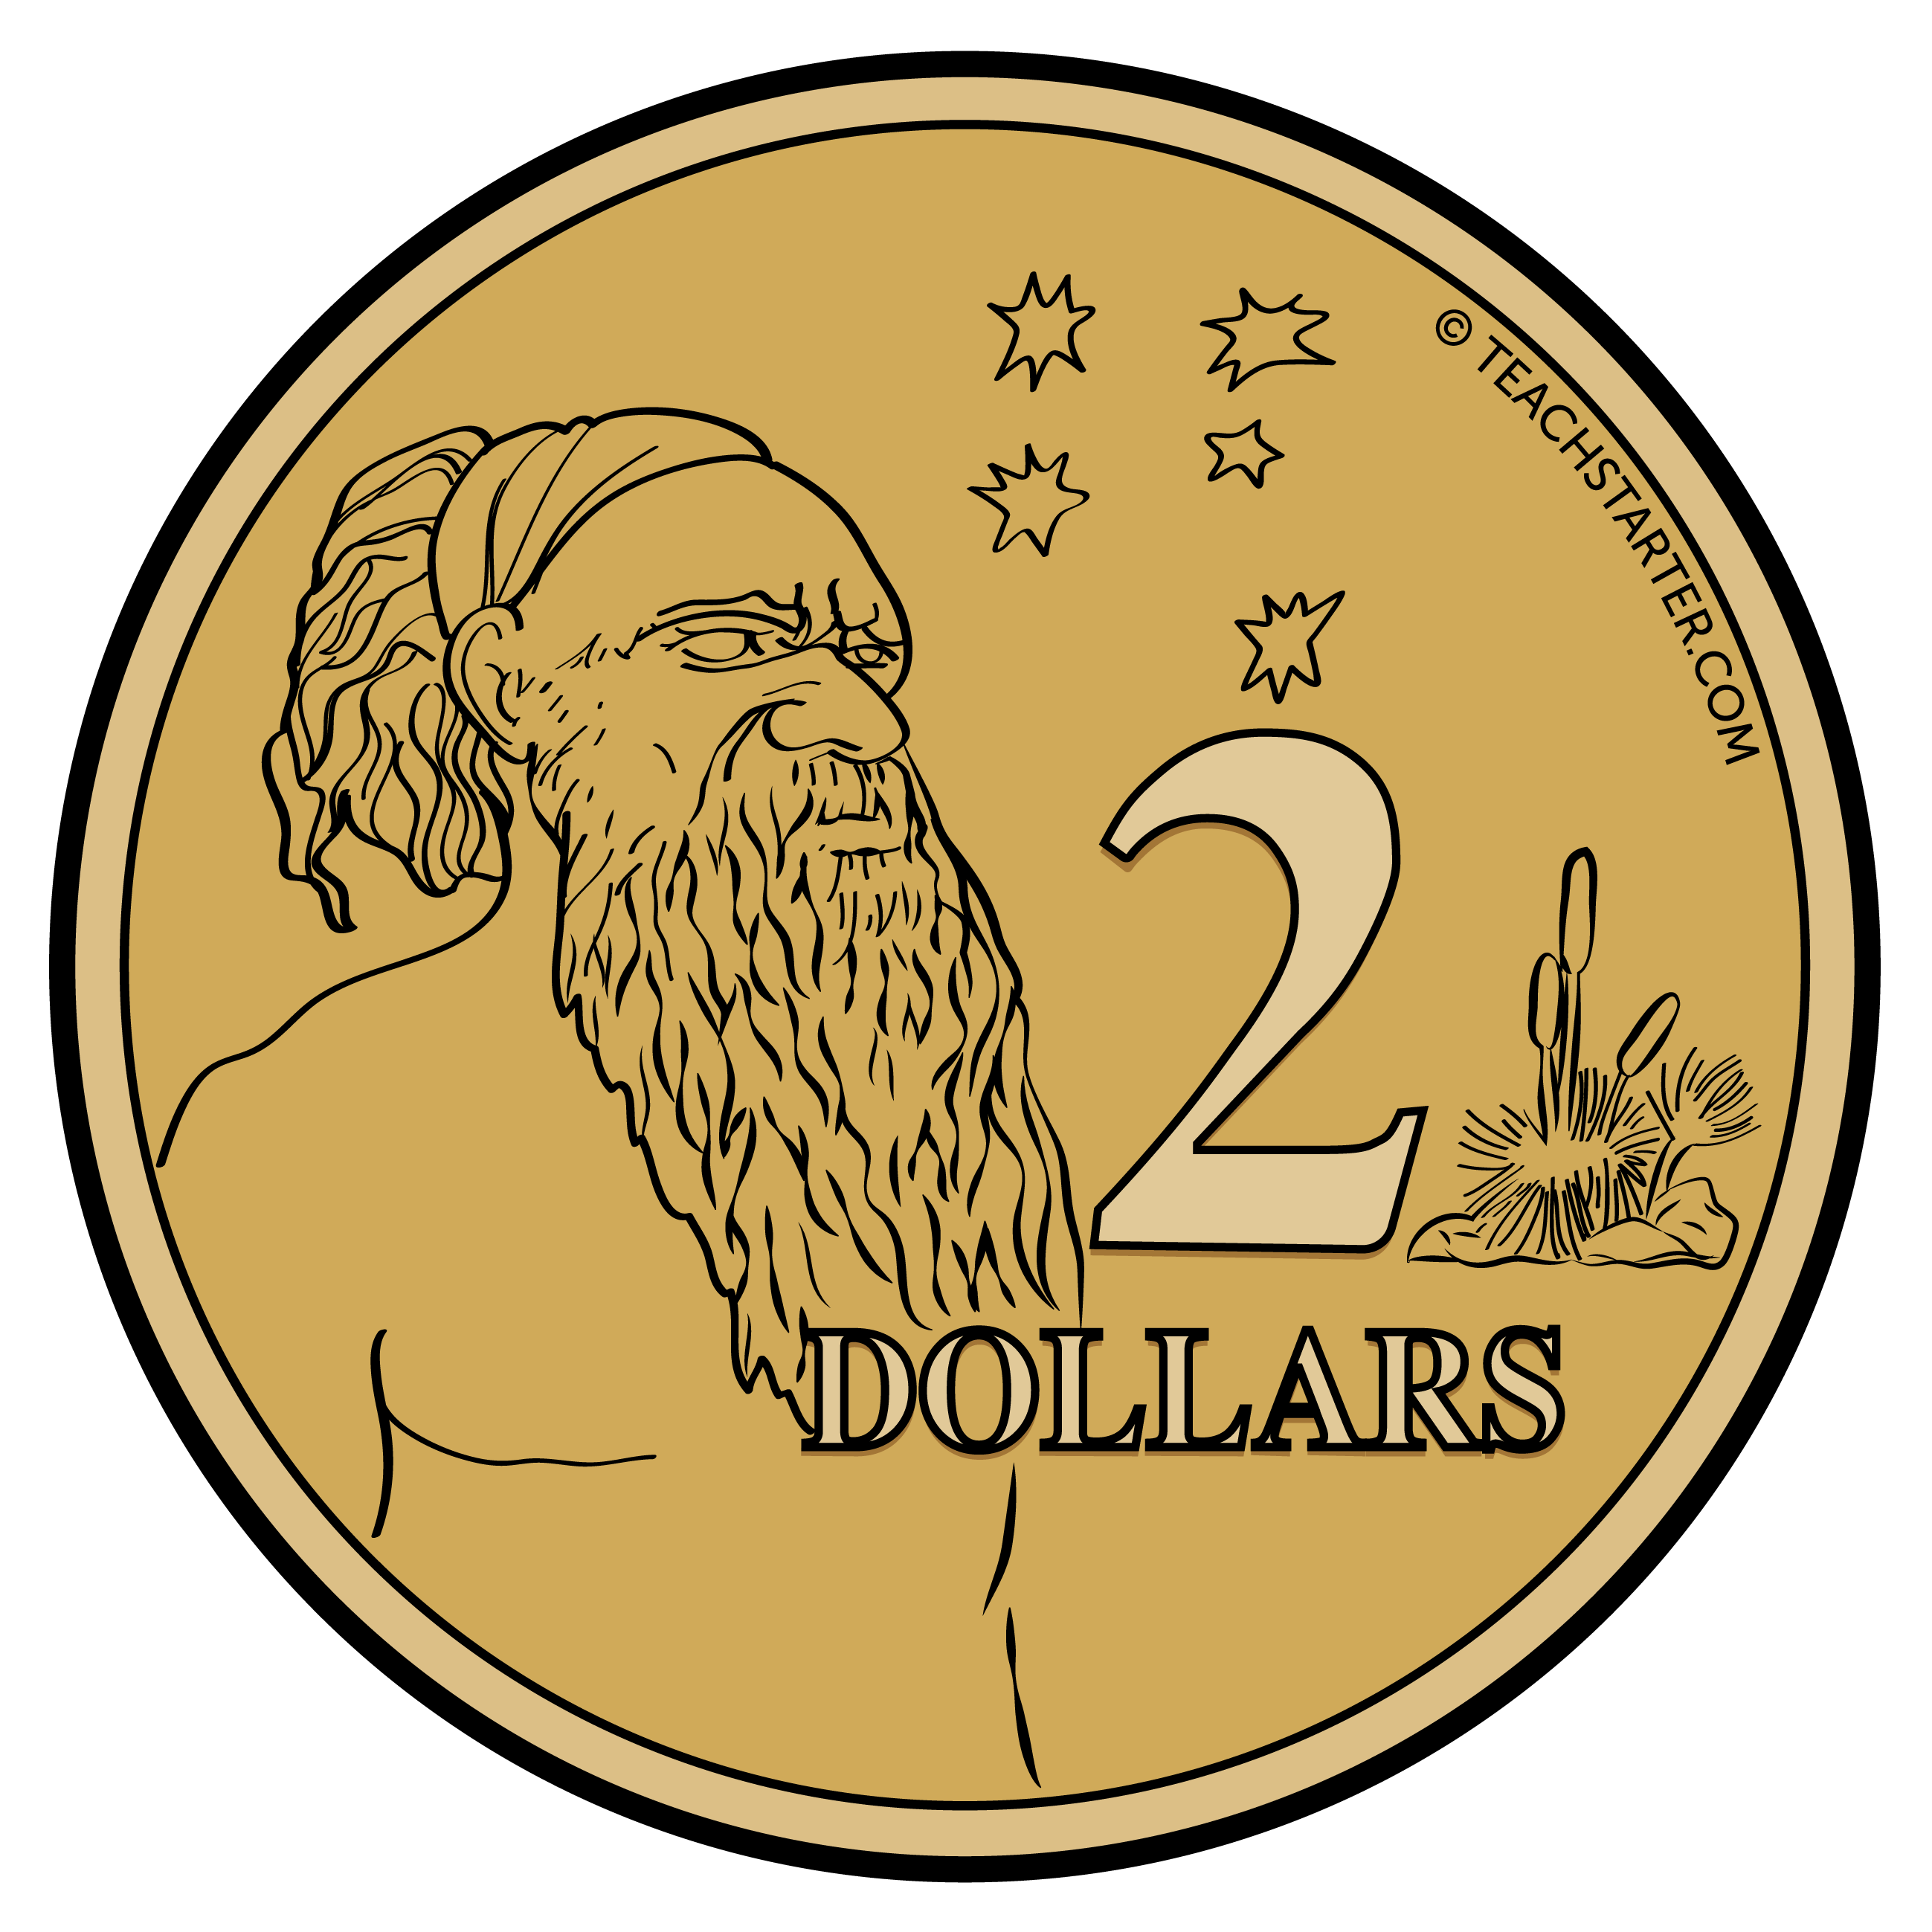
Australian Money
Coins
Five cents 5c
Notes
Five dollars $5
Ten cents 10c
Ten dollars $10
Twenty cents 20c
Twenty dollars $20
Fifty cents 50c
Fifty dollars $50
One dollar $1
One hundred dollars $100
Two dollars $2

Slide 3
1
John had $28 in his wallet.
What did the money in his wallet look like?

Slide 4
1
John had $28 in his wallet.
2 x $10 = $20 1 x $5 = $5 1 x $2 = $2 1 x $1 = $1 $20 + $5 + $2 + $1 = $28

Slide 5
2
Sarah had $92 in her piggybank.
What did the money in her piggybank look like?

Slide 6
2
In her piggybank, Sarah had a total of $92.
6 x $2 = $12 2 x $5 = $10 3 x $10 = $30 2 x $20 = $40 $12 + $10 + $30 + $40 = $92

Slide 7
3
Andy received a total of $55 in birthday money.
What did the money in Andy’s birthday card look like?

Slide 8
3
Andy received a total of $55 in birthday money.
3 x $5 = $15 2 x $10 = $20 1 x $20 = $30 $15 + $20 + $20 = $55

Slide 9
4
c
d
Mel received a total of $80 in birthday money.
What did the money in Mel’s birthday card look like?

Slide 10
4
Mel received a total of $80 in birthday money.
2 x $10 = $20 3 x $20 = $60 $20 + $60 = $80

Slide 11
5
Brian bought a new pair of shoes for $45.
What combination of money did Brian use to pay for his shoes?

Slide 12
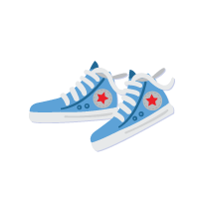
5
Brian bought a new pair of shoes for $45.
3 x $5 = $15 1 x $10 = $10 1 x $20 = $20 $15 + $10 + $20 = $45

Slide 13
6
Charlotte bought a new school bag for $32.
What combination of money did Charlotte use to pay for her bag?

Slide 14
6
Charlotte bought a new school bag for $32.
2 x $1 = $2 2 x $5 = $10 1 x $20 = $20 $2 + $10 + $20 = $32

Slide 15
7
Dominic bought a new pair of shorts for $15.
What combination of money did Dominic use to pay for his shorts?

Slide 16
7
Dominic bought a new pair of shorts for $15.
1 x $1 = $1 2 x $2 = $4 2 x $5 = $10 $1 + $4 + $10 = $15

Slide 17
8
Mrs. Thompson bought a new pair of glasses for $73.
What combination of money did she use to pay for her glasses?

Slide 18
8
Mrs. Thompson bought a new pair of glasses for $73.
1 x $1 = $1 1 x $2 = $2 1 x $10 = $10 3 x $20 = $60 $1 + $2 + $10 + $60 = $73

Slide 19
9
Isaac bought a new guitar for $92 and a packet of picks for $3.50.
What combination of money did Isaac use to pay for his items?

Slide 20
9
Isaac bought a new guitar for $92 and a packet of picks for $3.50.
Total cost = $95.50
1 x 50c = 50c 1 x $5 = $5 2 x $20 = $40 1 x $50 = $50 50c + $5 + $40 + $50 = $95.50

Slide 21
10
Lucy bought a new scarf for $18 and a beanie for $12.90.
What combination of money did Lucy use to pay for her items?

Slide 22
10
Lucy bought a new scarf for $18 and a beanie for $12.90.
Total cost = $30.90
2 x 20c = 40c 1 x 50c = 50c 1 x $10 = $10 1 x $20 = $20 40c + 50c + $10 + $20 = $30.90

Slide 23
11
Kiran bought a chicken drumstick for $3.40 and a drink for $2.65.
What combination of money did Kevin use to pay for his items?

Slide 24
11
Kiran bought a chicken drumstick for $3.40 and a drink for $2.65.
Total cost = $6.05
1 x 5c = 5c 5 x 20c = $1 1 x $1 = $1 2 x $2 = $4 5c + $1 + $1 + $4 = $6.05

Slide 25
12
Nikita bought a new swimsuit for $30.10 and a pool toy for $10.50.
What combination of money did Nikita use to pay for her items?

Slide 26
12
Nikita bought a new swimsuit for $30.10 and a pool toy for $10.50.
Total cost = $40.60
2 x 10c = 20c 2 x 20c = 40c 2 x $10 = $20 1 x $20 = $20 20c + 40c + $20 + $20 = $40.60

Slide 27
13
Oliver bought six new tennis balls for $3.50 each.
What combination of money did Oliver use to pay for his items?

Slide 28
13
Oliver bought six new tennis balls for $3.50 each.
Total cost = $21
2 x 50c = $1 1 x $1 = $1 2 x $2 = $4 3 x $5 = $15 $1 + $1 + $4 + $15 = $21

Slide 29
14
Ruby bought five new bracelets for $2.20 each.
What combination of money did Ruby use to pay for her items?

Slide 30
14
Ruby bought five new bracelets for $2.20 each.
Total cost = $11
5 x 20c = $1 2 x 50c = $1 2 x $2 = $4 1 x $5 = $5 $1 + $1 + $4 + $5 = $11

Slide 31
15
Michael bought three new shirts for $12 each.
What combination of money did Michael use to pay for his items?

Slide 32
15
Michael bought three new shirts for $12 each.
Total cost = $36
3 x $2 = $6 2 x $5 = $10 2 x $10 = $20 $6 + $10 + $20 = $36

Slide 33
16
Penny bought three new dresses for $23 each.
What combination of money did Penny use to pay for her items?

Slide 34
16
Penny bought three new dresses for $23 each.
Total cost = $69
2 x $2 = $4 1 x $5 = $5 1 x $10 = $10 1 x $50 = $50 $4 + $5 + $10 + $50 = $69.

Slide 35
17
Francisco used a $50 note to pay for a $32 costume.
What combination of money did Francisco receive in change?

Slide 36
17
Francisco used a $50 note to pay for a $32 costume.
Change: $50 - $32 = $18
1 x $1 = $1 1 x $2 = $2 1 x $5 = $5 1 x $10 = $10 $1 + $2 + $5 + $10 = $18

Slide 37
18
Hanna used a $50 note to pay for a $13 umbrella.
What combination of money did Hanna receive in change?

Slide 38
18
Hanna used a $50 note to pay for a $13 umbrella.
Change: $50 - $13 = $37
1 x $2 = $2 1 x $5 = $5 1 x $10 = $10 1 x $20 = $20 $2 + $5 + $10 + $20 = $37

Slide 39
19
Glen used two $20 notes to pay for a $27 soccer ball.
What combination of money did Glen receive in change?

Slide 40
19
Glen used two $20 notes to pay for a $27 soccer ball.
Change: $40 - $27 = $13
1 x $1 = $1 1 x $2 = $2 2 x $5 = $10 $1 + $3 + $10 = $13

Slide 41
20
Jenny used three $20 notes to pay for a $42 helmet.
What combination of money did Jenny receive in change?

Slide 42
20
Jenny used three $20 notes to pay for a $42 helmet.
Change: $60 - $42 = $18
1 x $1 = $1 1 x $2 = $2 1 x $5 = $5 1 x $10 = $10 $1 + $2 + $5 + $10 = $18

